Slide 1






Room A
LEGEND
REWARD: 1.0
Destination
Target
Red path
(must follow)
Dead End
Voice
command
Audio
source

Slide 2
Room B
LEGEND
REWARD: 3.0
Destination
Target
Red path
(must follow)
Dead End
Voice
command
Audio
source

Slide 3


Room C
LEGEND
REWARD: 2.5
Destination
Target
Red path
(must follow)
Dead End
Voice
command
Audio
source
Turn left!

Slide 4
Room D
LEGEND
REWARD: 2.0
Destination
Target
Red path
(must follow)
Dead End
Voice
command
Audio
source

Slide 5
Room A
LEGEND
REWARD: 8.0
Destination
Target
Red path
(must follow)
Dead End
Voice
command
Audio
source
Turn left!

Slide 6

Room B
LEGEND
REWARD: 10.0
Destination
Target
Red path
(must follow)
Dead End
Voice
command
Audio
source
Turn left!

Slide 7
Room C
LEGEND
REWARD: 7.5
Destination
Target
Red path
(must follow)
Dead End
Voice
command
Audio
source

Slide 8
Room D
LEGEND
REWARD: 6.0
Destination
Target
Red path
(must follow)
Dead End
Voice
command
Audio
source

Slide 9
Room A
LEGEND
REWARD: 10.0
Destination
Target
Red path
(must follow)
Dead End
Voice
command
Audio
source

Slide 10
Room B
LEGEND
REWARD: 10.0
Destination
Target
Red path
(must follow)
Dead End
Voice
command
Audio
source

Slide 11
Room C
LEGEND
REWARD: 25.0
Destination
Target
Red path
(must follow)
Dead End
Voice
command
Audio
source
Turn left 45º counter-clockwise!

Slide 12
Room D
LEGEND
REWARD: 7.0
Destination
Target
Red path
(must follow)
Dead End
Voice
command
Audio
source

Slide 13
Room A
LEGEND
REWARD: 3.0
Destination
Target
Red path
(must follow)
Dead End
Voice
command
Audio
source

Slide 14



Room B
LEGEND
REWARD: 4.0
Destination
Target
Red path
(must follow)
Dead End
Voice
command
Audio
source

Slide 15
Room C
LEGEND
REWARD: 5.0
Destination
Target
Red path
(must follow)
Dead End
Voice
command
Audio
source
Turn left 45º counter-clockwise!

Slide 16
Room D
LEGEND
REWARD: 2.0
Destination
Target
Red path
(must follow)
Dead End
Voice
command
Audio
source

Slide 17
Room A
LEGEND
REWARD: 6.0
Destination
Target
Red path
(must follow)
Dead End
Voice
command
Audio
source

Slide 18


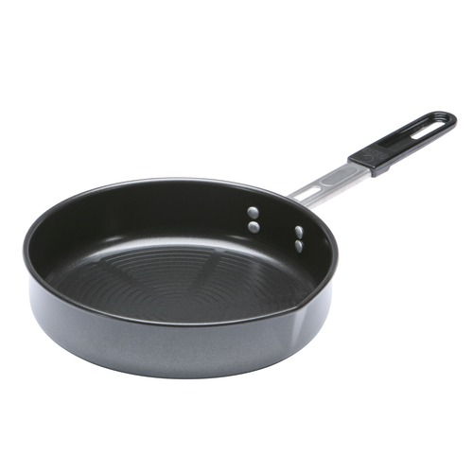
Room B
LEGEND
REWARD: 3.0
Destination
Target
Red path
(must follow)
Dead End
Voice
command
Audio
source

Slide 19
Room C
LEGEND
REWARD: 20.0
Destination
Target
Red path
(must follow)
Dead End
Voice
command
Audio
source

Slide 20
Room D
LEGEND
REWARD: 5.0
Destination
Target
Red path
(must follow)
Dead End
Voice
command
Audio
source

